Slide 1

The Agricultural Act of 2014:
Update on STAX, SCO
& Farm Bill Implementation
Casa Grande, AZ
November 2014

Slide 2
2014 Farm Bill
Fundamental changes in cotton’s safety net
  DP and CCP programs discontinued
Greater reliance on crop insurance products
Maintains marketing loan
Across commodities, growers faced with new program choices
Targeted for phase-in over ‘14 and ‘15 crops
Unless otherwise noted, sequestration applies to FSA programs but not crop insurance

Slide 3
2014 Cotton Transition Assistance
New insurance products available in 2015
Transition program for cotton for the 2014 crop
  Equates to 5.4 cents/lb. on all 2013 base acres and DP yield;
Subject to separate limit of $40k/legal entity
Eligibility not affected by other program choices or planting decisions
Payments occur on/after Oct 1, 2014

Slide 4
Basic STAX Concept

Slide 5
Stacked Revenue Protection Plan
STAX – new revenue insurance product available in 2015 for purchase on all acres planted to upland cotton; administered by USDA’s RMA
Indemnities triggered by revenue experience at county level (or combined counties if necessary for actuarially sound product); STAX indemnities NOT based on individual experience
Offered by irrigated/non-irrigated practice to greatest extent possible

Slide 6
Basic STAX Concept
Individual Revenue
County Revenue
County Revenue > 90%, then no STAX indemnity
Deductible
Deductible
90%
STAX
70%
Individual Coverage
County Revenue at or below 70%, STAX indemnity at max

Slide 7
Basic STAX Calculations
Description |  | Example
Expected County Revenue = Insurance Projected Price x Expected County Yield | Insurance Projected Price | $0.65
 | Expected County Yield | 1,000 lbs
 | Expected County Revenue | $650
Actual County Revenue = Insurance Harvest Price x Actual County Yield | Insurance Harvest Price | $0.60
 | Actual County Yield | 850 lbs
 | Actual County Revenue | $510
Indemnity is lesser of amount that 90% of Expected County Revenue exceeds Actual County Revenue or 20% of Expected County Revenue | 90% of Exp. County Revenue | $585
 | 20% of Exp. County Revenue | $135
 | Indemnity | $75
Notes:
The table shows a basic illustration of the STAX concept and how the program would have in past years.
In 2008, an indemnity would have been triggered based on a sharp price decline between the beginning of the year and the end of the year.
In 2009, prices increased during the year and county yields exceeded expectations, so no indemnity was triggered. Even though at the beginning of the year, the futures prices was below the reference price, prices increased by harvest and yields came in above average. As a result, no indemnities were triggered.

Slide 8
STAX Availability

Slide 9
Availability of STAX
STAX will be offered in all counties in which underlying cotton crop insurance products are offered – includes more than 700 counties
Offer at a county-level to the greatest extent possible
If county does not have enough acres & producers for actuarial soundness, then counties will be combined.

Slide 10
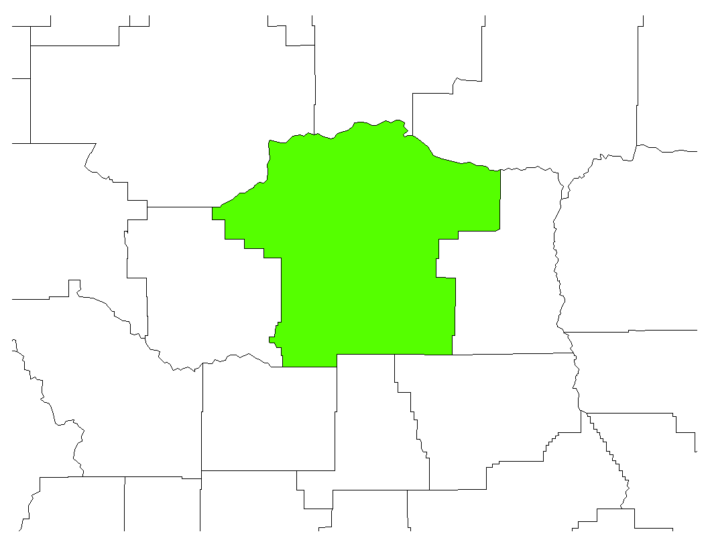
Stand-alone or Primary County
County has (by practice)
10+ years of history
10,000+ acres in past 5 years
20+ producers in past 5 years
Actuarial offer will include yield history and final yield of only that county (by practice)
Some room for judgment for counties that miss criteria by a small amount
Accounts for 80% of acres

Slide 11
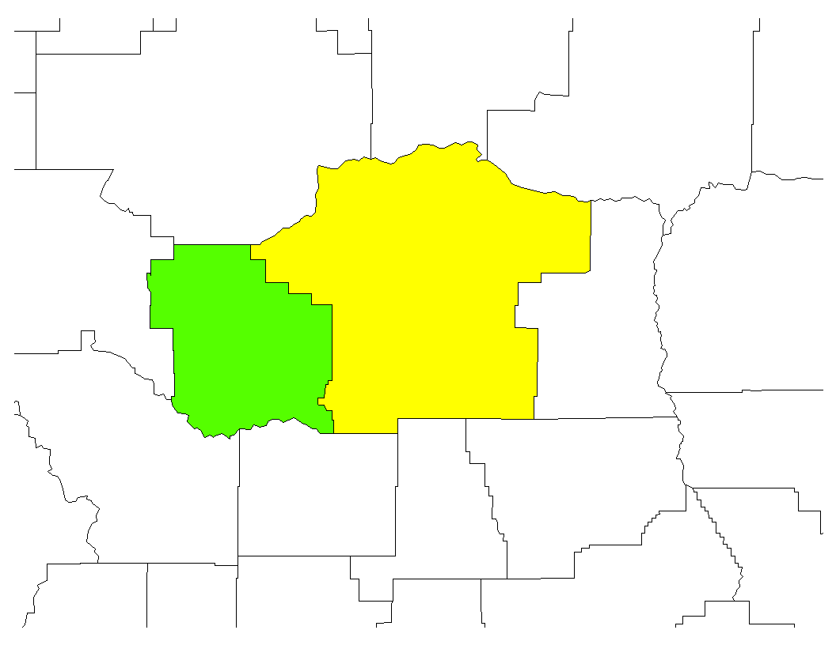
Two County Group (or Proxy County)
County missing one (+) criteria and:
Is adjacent to a stand-alone
Actuarial offer will include yield history and final yield of that county and the adjacent county
If more than one adjacent county qualifies one is picked considering:
  Yield correlation
  Acreage of stand-alone county
Primary county continues to stand on its own.
Accounts for another 7-8% of acres.

Slide 12
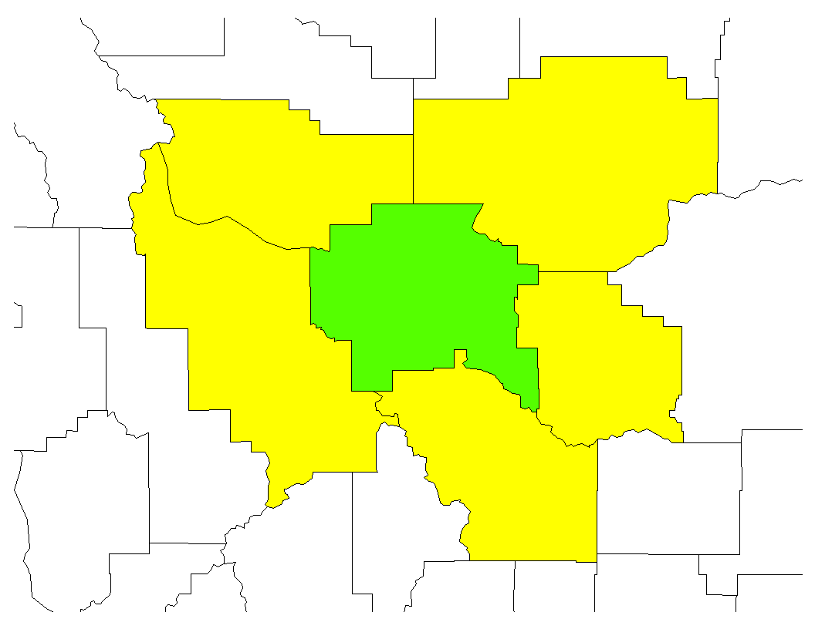
Circle Group
County missing criteria and:
Is adjacent to a stand-alone
Can meet criteria when combined with surrounding adjacent counties?
Actuarial offer will include yield history and final yield of that county and all of the adjacent counties
Covers another 7-8% of acres.

Slide 13
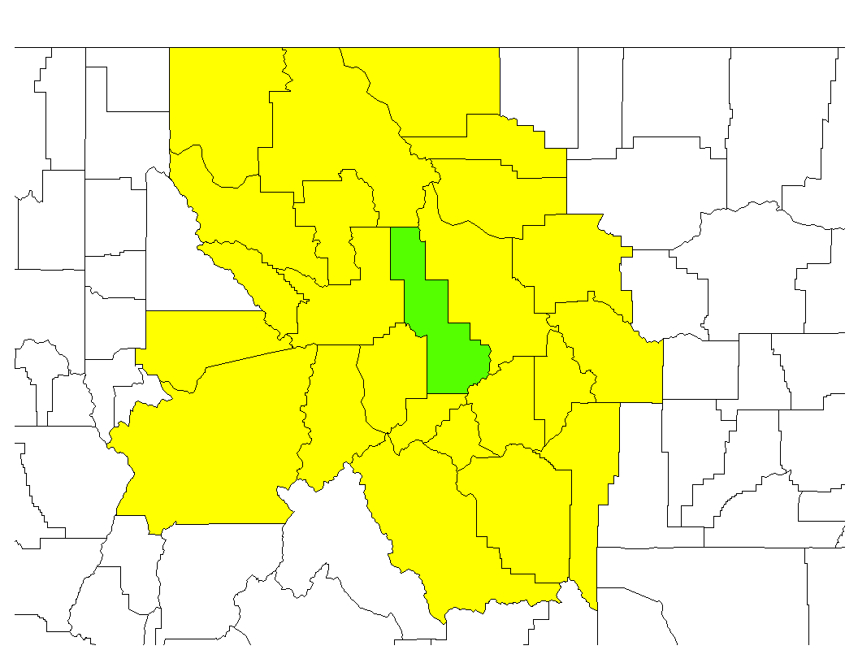
Double Circle and NASS District
County missing criteria and:
Is adjacent to a stand-alone
Can meet criteria when combined with adjacent counties
Can meet criteria when combined with counties at double circle or NASS crop reporting district level
Actuarial offer will include yield history and final yield of that county and (the option with fewer acres):
  All of the adjacent counties and counties adjacent to them
  All counties in the NASS district

Slide 14
Outliers
Possible Group Options
Nearest stand-alone county
  Practice specific
Triple Circle
Non-irrigated practice in the county
  For irrigated practice only
  Yield variance of practices considered
Geographic grouping
  e.g. a series of counties that all have similar soil, climate, etc.

Slide 15
Finding Your Production Area
RMA refers to the counties and county groupings as Production Areas
Production Areas will be reevaluated periodically to determine if still appropriate
Maps of Production Areas are posted at http://www.rma.usda.gov/news/currentissues/staxsco/

Slide 16
STAX Yields

Slide 17
STAX Expected & Actual Yields
Expected & Actual Yields for STAX are based on crop insurance data
  Allows for practice specific data in more areas
  Enables aggregation into larger groups
RMA yields for area plans are based on future projection of yields
  Includes projection of yield trends (by practice)
  Exceptional years (high or low) can be given less weight when calculating projected yield
STAX Expected Yield may also be based on 5-yr Olympic average
  Only if the Olympic average is higher than RMA’s projected yield

Slide 18

Crop Insurance and NASS Data
Data drawn from a sample county
Note that NASS published an aggregated yield for this county
RMA to publish their historical yields

Slide 19
STAX Choices

Slide 20
STAX & Harvest Price Option
As with existing revenue products, producers have choice to include or exclude the Harvest Price Option (HPO)
  If the Harvest Price is above Projected Price, then HPO will indemnify yield losses at the higher harvest price
  Overwhelmingly, purchases of individual revenue policies include HPO
Choices are:
  STAX – Revenue Protection or
  STAX – Revenue Protection with Harvest Price Exclusion

Slide 21
STAX & Coverage Band
The widest STAX coverage band is from 90% to 70%
Both upper and lower end of the range are adjustable in 5% increments
10 coverage bands:
  90-70%, 90-75%, 90-80%, 90-85%
  85-70%, 85-75%, 85-80%
  80-70%, 80-75%
  75-70%

Slide 22
STAX & the Protection Factor
Select Protection Factor
  Feature in existing area-wide insurance products
  Choose in 1 percentage point increments between 80% and 120%
  Under a 90-70% STAX policy, the Protection Factor doesn’t change when an indemnity is triggered, i.e. there must be a 10% loss in county revenue
  But the Protection Factor will adjust any indemnity up of down by up to 20% based on selected factor
  Increases liability and increases premium

Slide 23
Impact of Protection Factor
Assuming Expected County Revenue = $600
120% Protection Factor
80% Protection Factor

Slide 24
STAX Liability & Premiums

Slide 25
STAX Yields & Premium Rates
RMA has released expected yields for all counties
Premium rates also published
  Since a revenue policy, rates published across a range of price volatility factors
Information available at Actuarial Information Browser of RMA website http://webapp.rma.usda.gov/apps/actuarialinformationbrowser2015/CropCriteria.aspx

Slide 26
STAX Premium Subsidy
Premium subsidy is 80%, equals highest available under existing products
 | Coverage Level % | 50 | 55 | 60 | 65 | 70 | 75 | 80 | 85 | 90
Individual Yield & Revenue | Basic & Optional | 67 | 64 | 64 | 59 | 59 | 55 | 48 | 38
 | Enterprise | 80 | 80 | 80 | 80 | 80 | 77 | 68 | 53
Area-wide Yield/Revenue |  |  |  |  |  | 64 | 64 | 59 | 59 | 55

Slide 27
Pinal Co, AZ STAX Calculations*
Premium based on STAX with Harvest Price Option an assumes price volatility factor of 0.15. Final volatility factor will be determined during price discovery period.
Notes:
The table shows a basic illustration of the STAX concept and how the program would have in past years.
In 2008, an indemnity would have been triggered based on a sharp price decline between the beginning of the year and the end of the year.
In 2009, prices increased during the year and county yields exceeded expectations, so no indemnity was triggered. Even though at the beginning of the year, the futures prices was below the reference price, prices increased by harvest and yields came in above average. As a result, no indemnities were triggered.

Slide 28
STAX & Underlying Coverage

Slide 29
STAX & Existing Insurance Coverage
Designed to be a complement to existing coverage
May be purchased as the only insurance policy covering that acre; or purchased in addition to CAT coverage or existing buy-up product
  Note: Lower band of STAX coverage may not overlap the coverage level of another insurance policy on that same acre

Slide 30
Insurance Coverage Choices
Deductible
Maximum STAX
Uncovered Range
Underlying Coverage

Slide 31
Cotton Crop Insurance Usage

Slide 32
Illustration for Pinal Co, AZ
* Assumes EU coverage for underlying revenue policy, price election of $0.65, price volatility of 0.15, and APH equal to county average expected yield.

Slide 33
Supplemental Coverage Option

Slide 34
Supplemental Coverage Option
New product for upland cotton & other crops beginning in 2015
May not be purchased on cotton acres covered by STAX
Must purchase underlying insurance policy
  Provides coverage for portion of a producer’s deductible
Indemnities triggered on county yield or revenue experience, depending on underlying coverage

Slide 35
Additional SCO Features
SCO deductible is 14%
  Indemnities triggered if county yield/revenue falls below 86% of expected yield/revenue
  % by which county yield/revenue falls below 86% determines indemnity that is adjusted based on value of the producer’s individual indemnity
SCO coverage extends down to the coverage level of the underlying policy
SCO premium subsidy is 65%

Slide 36
Considerations for STAX or SCO
 | SCO | STAX
Underlying Coverage Required | Yes | No
Area-wide Trigger | Yes; Yield or Revenue; depending on ind. policy | Yes; Revenue
Deductible | 14% fixed | 10% minimum
Coverage Band | Down to underlying coverage | Down to 70%
Premium Subsidy | 65% | 80%
Indemnity | Paid on % of Individual’s deductible | Paid on county shortfall, adjusted by protection factor

Slide 37
Key Questions
Is your individual APH well above the expected county yield?
Is your underlying coverage less than 70%?
Remember that both STAX and SCO trigger off county experience, at 90% & 86%, respectively.

Slide 38
Pinal Co, AZ STAX & SCO*
* Premium based price volatility factor of 0.15.
Notes:
The table shows a basic illustration of the STAX concept and how the program would have in past years.
In 2008, an indemnity would have been triggered based on a sharp price decline between the beginning of the year and the end of the year.
In 2009, prices increased during the year and county yields exceeded expectations, so no indemnity was triggered. Even though at the beginning of the year, the futures prices was below the reference price, prices increased by harvest and yields came in above average. As a result, no indemnities were triggered.

Slide 39
Other Crop Insurance Changes
Enhanced coverage options by enterprise units
    Makes permanent 80% premium subsidy
    Allows for enterprise unit coverage by irrigated and non-irrigated practices
Allows for different coverage levels by irrigated/non-irrigated practice

Slide 40
Other Crop Insurance Changes
Adjustment in APH insurable yields
    Producer may opt to exclude any year from APH if yield in county in that year is less than 50% of ten-year county average; Also applies to contiguous counties and allows for the separation of irrigated and non-irrigated acres
    More details in December
  Peanut revenue coverage
Conservation compliance required for insurance premium subsidy
  Must file AD-1026 by June 1, 2015

Slide 41
Other Farm Bill Issues

Slide 42
Key Decision Dates
Sep 29, ‘14 – Feb 27, ‘15: Retain or re-allocate covered commodity bases and update payment yield by landowner
Nov 17, ‘14 – Mar 31, ’15: PLC or ARC per farm per covered commodity base by all producers (POA)
April ‘15 – Summer ’15: ‘14 and ‘15 crop annual sign-up
Oct ‘15 – ‘14 PLC/ARC payments due

Slide 43
Payment Acres for PLC or ARC-CO
85% of sum of base acres for each covered commodity and any generic base attributed to the covered commodity
When generic acres planted to one or more covered commodities, special rules for calculating total payment acres

Slide 44
Understanding Generic Base
Did the farm have cotton base in 2013?
  If yes, then those base acres became generic base in 2014 through 2018.
Are there (or will there be) covered commodities (grains, oilseeds, rice, peanuts) planted on the farm in ‘14-18?
  If yes, then all or a portion of generic base acres eligible to receive PLC/ARC payments in that year.

Slide 45
Attributing Generic Base
2015 Base | Generic | Wheat | Total
# of Base Acres | 100 | 100 | 200
2015 Planted | Cotton | Wheat | Total
# of Planted Acres | 100 | 100 | 200
(Individual Covered Commodity Planted) as % of (Total Covered Commodity Planted) |  | 100/100 = 100%
Generic Base Attributed |  | 100
2015 Effective Base for PLC/ARC |  | 200 | 200
2015 Payment Acres for PLC/ARC | 0 | 85%*200 | 170

Slide 46
Upland Cotton Marketing Loan
Loan rate set by formula using average of AWP for 2 most recently completed marketing years, as of Oct 1 in year prior to planting
  Loan rate does not change during marketing year
Loan rate for base quality not less than 45 cents or greater than 52 cents
For 2015, base loan rate set at 52 cents
MLGs & LDPs now subject to payment limit

Slide 47
Payment Limits
$125K limit/entity for PLC, ARC, MLG, LDP
  Separate limit for peanuts
  Does not apply to eligibility for crop insurance premium subsidies
USDA developing interim and longer-term process for applying MLG/LDP to payment limit
Coops or producer responsible for overpayment
NCC Briefing Paper included in handout

Slide 48
AGI Means Test
If 3-yr avg AGI > $900K, then ineligible for PLC, ARC, MLG and LDP
New procedure for AGI certification/verification
  Producer must file CCC-941
  IRS will verify eligibility
  Coops and LSAs can redeem loans at AWP w/o verifying certification/verification
  Producer can redeem loans at AWP/receive LDP if certification on file prior to verification by IRS
    If determined ineligible, repayment required

Slide 49
Resources
Texas A&M Ag and Food Policy Center decision tool https://decisionaid.afpc.tamu.edu/
University of Illinois farm bill toolbox http://farmbilltoolbox.farmdoc.illinois.edu/
USDA-RMA Farm Bill page http://www.rma.usda.gov/news/currentissues/farmbill/index.html
USDA-FSA website http://www.fsa.usda.gov/FSA/
Check your state university extension website

Slide 50
Final Questions?
Presentation and Summary available for NCC members at www.cotton.org
Producers
Cooperatives
Ginners
Cottonseed
Merchants
Warehouses
Manufacturers

