Slide 1
Plastics in Cotton Seminar Texas Agrilife Extension Webinar May 6, 2020

Slide 2
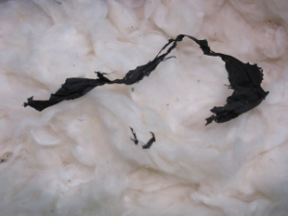
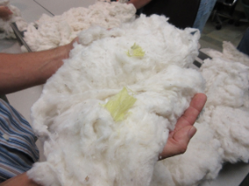
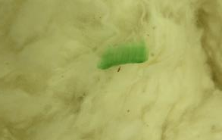
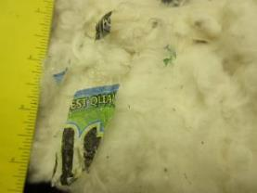
CONTAMINATION FROM PLASTICS
Plastics have been a concern for many years
Plastics have become the most prevalent non-plant contaminant since the 2017-18 crop year
There are many types and forms
Notes:
46
Through mid-May, plastic had been found in 2,614 samples by USDA AMS.
64% of those calls were made on samples from the southwest, 20% from the mid-south, 14% from the southeast and 2% from the west.
Of 548 gins- 349 had plastic calls (64% of gins)
OIL and WATER potential for warehouse contamination- appreciate keeping an eye out for any potential contamination sources
Trade rule changes- may impact warehouse if it is found that the contaminate came from the warehouse

Slide 3
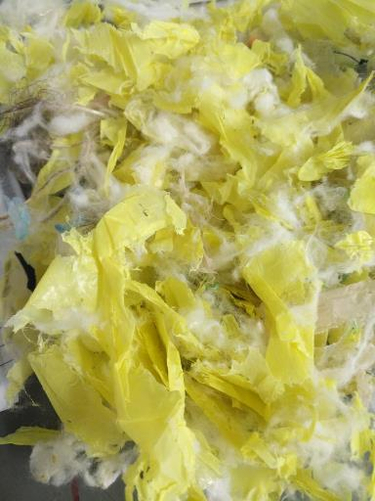
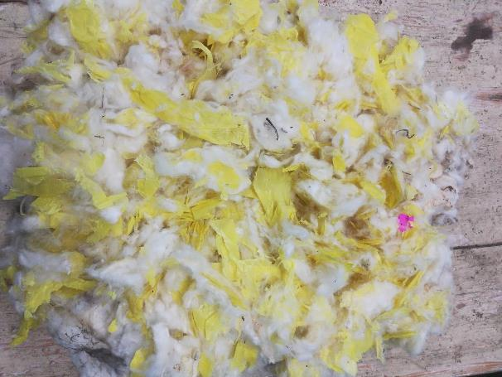
Pakistan Mill 7/1/18

Slide 4
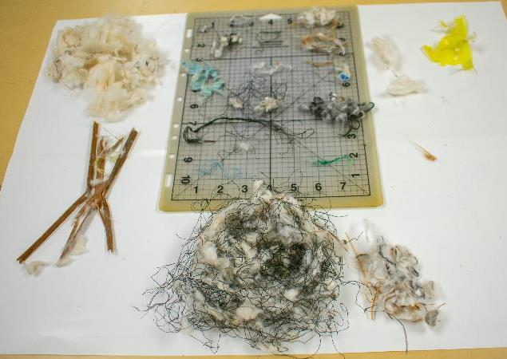
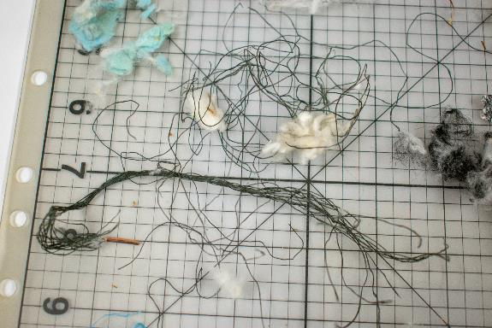
Vietnamese Mill 7/24/18

Slide 5
Plastic by Region for 2017 Crop
Southeast | 360
Florence | 65
Macon | 295
 | 14%
Mid-South | 514
Dumas | 196
Memphis | 283
Rayville | 35
 | 20%
Southwest | 1,676
Abilene | 117
Corpus | 432
Lamesa | 46
Lubbock | 1,041
 | 64%
Far West | 64
Upland | 35
Pima | 29
 | 2%
Total US | 2,614
Upland | 2,585 | 98.9%
Pima | 29 | 1.1%
USDA/AMS thru 5/17/2018

Slide 6
Plastic vs Other for 2017 Crop
(thru 5/17/2018)
91% of all 61 Calls were Plastic

Slide 7
Plastic by Color for 2017 Crop
(thru 2/28/2018 per USDA/AMS)

Slide 8
Contamination Summit
Memphis May 22-24, 2018
Focused on Prevention Education and Research on Detection and Removal
Producer, Ginner and Merchant Leaders
USDA/AMS, Cotton Incorporated, Researchers
The Cotton Foundation: Deere, TAMA and Lummus

Slide 9
Merchant thoughts on Liability
ICA Rule 230:
... The buyer will be able to claim reasonable expenses from the seller for removal of the foreign matter.

Slide 10
Merchant thoughts on Liability
Rule Change at ICA?
ICA rule change has been discussed, shifting more liability to shippers.
A rule change for contamination inside a bale of cotton could start a wave of litigation.

Slide 11
Merchant thoughts on Liability
Consequences:
As a commercial decision, merchants routinely pay claims.
Controlling fees are becoming more expensive.
Cleaning fees can be subjective.
Labor costs are increasing in consumptive markets.

Slide 12
Merchant thoughts on Liability
Plastic contamination in U.S. cotton is jeopardizing our “contamination free” reputation.
Instances of contamination at classing offices are growing at an alarming rate.
Our customers are vocal about issues caused by contamination.
Our industry must solve the problem together.

Slide 13
USDA AMS 2018 ANNOUNCEMENT:
New plastic code (71 or 72) implemented July 1 beginning with the 2018 crop to distinguish Plastic from Other Extraneous Matter (61 or 62).

Slide 14
Plastic Contamination 2017/18 vs 2018/19 vs. 2019/20 Crops
Samples Called Plastic

Slide 15
2019 Crop Plastic 71 & 72 by Office

Slide 16
Rate of Plastic Calls Per Classing Office
SE:
Florence
1 / 17,000
Macon
1 / 7,000
Rayville
1 / 7,200
Dumas
1 / 2,700
Memphis
1 / 6,700
MS:
SW:
Abilene
1 / 5,200
Corpus
1 / 1,350
Lamesa
1 / 11,000
Lubbock
1 / 4,000
W:
Visalia
1 / 2,500

Slide 17
2019/20 Crop - Plastic Calls by Color

Slide 18
All Extraneous Matter for 2019 Crop
Bales

Slide 19
Prevention of Plastic Contamination
Why? Lost reputation/lost market potential
…significant loan discounts
2018/19 - 71: -460 72: -695
2019/20 - 71: -510 72: -775
2020/21 - 71: -1870 72: -2080
CONCERN IS HOW MANY ARE NOT CALLED

Slide 20
Contamination Prevention NCC and JCIBPC Policy
Prevention is CRITICAL:
Revise and update educational material
Contamination Awareness and Prevention efforts with growers, ginners & warehouses
Closely monitor complaints from mills and shippers
Internet form for reporting contamination incidents
Notes:
Within NCC Staff is working on….

Slide 21
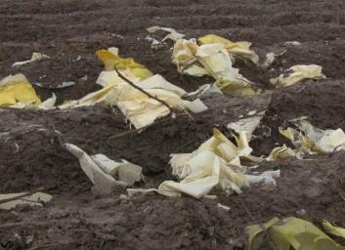
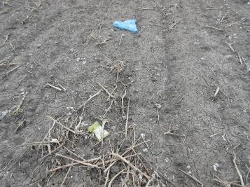
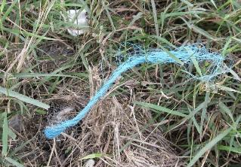
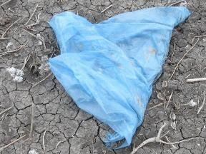
Prevention Begins in the Field
Notes:
Producers MUST police their fields before harvest. We can prevent much of the contamination starting in the field.
Common contaminants found include:
Plastic shopping bags
Ditch liners
Poly Pipe
Ag mulch
Polypropylene Twine
Module wrap
Etc.

Slide 22
Education Video
National Cotton Council Website:
http://www.cotton.org/tech/quality/contamfree.cfm
National Cotton Council YouTube:
https://www.youtube.com/watch?v=5Pja_HbMElA

Slide 24
Education Video
National Cotton Council Website:
http://www.cotton.org/tech/quality/contamfree.cfm
National Cotton Council YouTube:
https://www.youtube.com/watch?v=5Pja_HbMElA

Slide 26
trustUScotton.org

Slide 27
Questions?
Thank you!

